Slide 1
MODULE 1
CLAMPER

Slide 2
CLAMPING CIRCUITS
Level shifter/ Dc restorer
A circuit that shifts either positive or negative peak of the signal at a desired dc levels.
It adds DC signal to shift
Three types
Positive clamper
Negative clamper
Biased clamper

Slide 3
ANALYSIS PROCEDURE
Start the analysis by considering that part of the input signal that will Fbes the diode
During the period that the diode is Fbed assume that the capacitor will charge up instantaneously to a voltage level determined by the network.
Assume that during the period when diode is RBed condition the C will hold onto its established voltage level

Slide 4
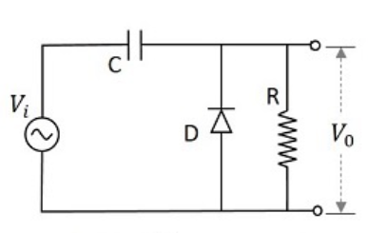
POSITIVE CLAMPER AT 0V
When the circuit pushes the signal towards the positive side it is called positive clamper

Slide 5
During negative half cycle
diode conducts and capacitor charges to +Vm volt with +ve polarity at the right side of capacitor
-Vm+Vc+0.6 = 0
Vc=Vm-0.6
During positive half cycle
Capacitor cannot discharge -diode does not conduct.
Vin+Vc-Vo = 0
Vo = Vin+Vc
Vo = Vin+Vm - 0.6

Slide 6
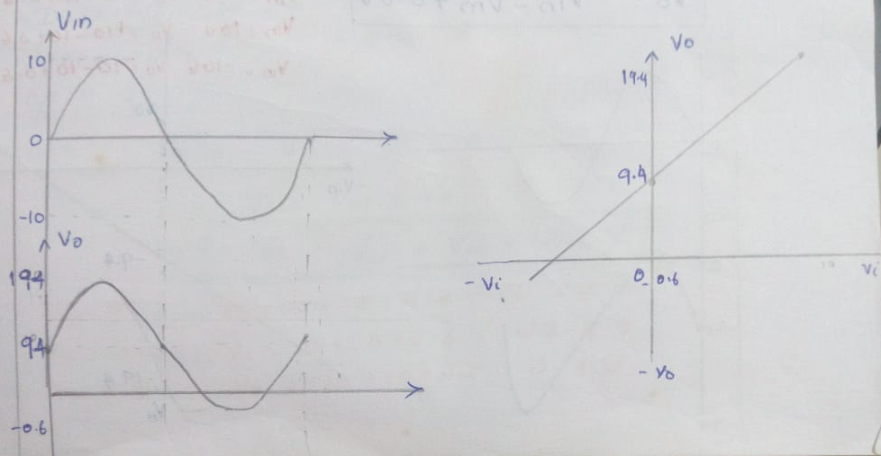

Slide 7
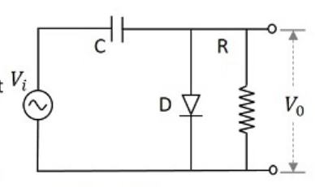
NEGATIVE CLAMPER AT
0 V
A Negative Clamper circuit is one that consists of a diode, a resistor and a capacitor and that shifts the output signal to the negative portion of the input signal

Slide 8
During positive half cycle
diode conducts and capacitor charges to +Vm volt with -ve polarity at the right side of capacitor
Vm-Vc-0.6 = 0
Vc=Vm-0.6
During negative half cycle
Capacitor cannot discharge -diode does not conduct. Capacitor acts as battery of Vm volts
Vin-Vc-Vo = 0
Vo = Vin-Vc
Vo = Vin-Vm +0.6

Slide 9
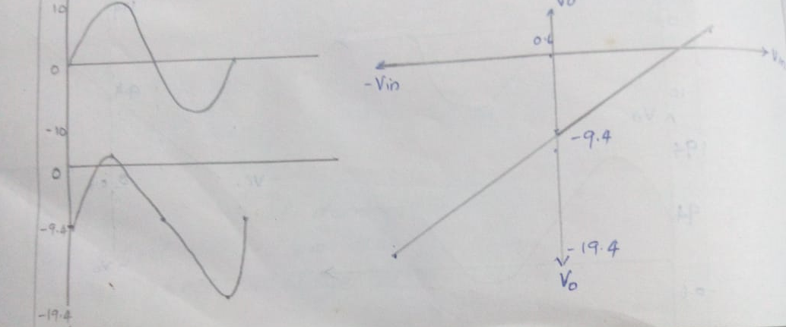

Slide 10
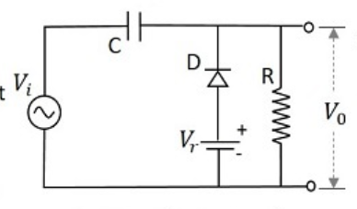
BIASED CLAMPER
Positive Clamper with Positive Vr(3V)
A Positive clamper circuit if biased with some positive reference voltage, that voltage will be added to the output to raise the clamped level.

Slide 11
during negative half cycle
diode conducts and capacitor charges till Vm+3V volt with +ve polarity of capacitor at o/p end
-Vm+Vc+0.6-3V = 0
Vc=Vm+2.4 V
During positive half cycle
capacitor cannot discharge since diode is RBed .
Vin+Vc-Vo = 0
Vo = Vin+Vc
Vo = Vin+Vm+2.4V

Slide 12
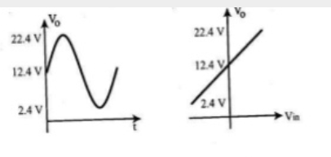

Slide 13
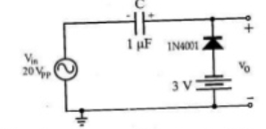
Positive Clamper with Negative Vr(-3V)
During negative half cycle diode gets FBed and capacitor charges to
-Vm+Vc+0.6+3 = 0
Vc = Vm-3.6V

Slide 14
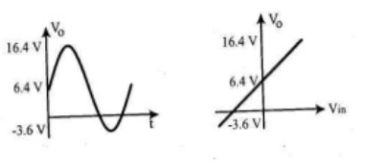
During positive half cycle diode gets RBed. and acts as open switch
Vin+Vc-Vo = 0
Vo = Vin+Vc
Vo = Vin+Vm - 3.6V

Slide 15
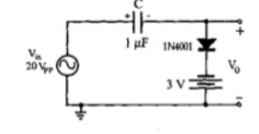
Negative clamper at negative volt(-3V)
During positive half cycle D conducts capacitor charges to
Vm-Vc-0.6+3V=0
Vc=Vm+2.4
During negative cycle diode gets RBed
Vin-Vc-Vo = 0
Vo = Vin-Vc
Vo = Vin-Vm-2.4

Slide 16
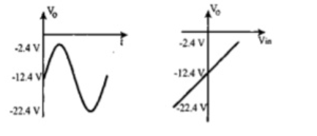
Vo = Vin-Vm-2.4

Slide 17
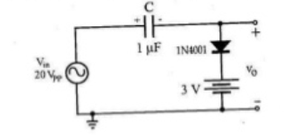
Negative Clamper at +V volt
During positive half cycle D gets FBed and capacitor charges to
Vm-Vc-0.6-3V=0
Vc=Vm-3.6
During negative cycle diode gets RBed
Vin-Vc-Vo = 0
Vo = Vin-Vc
Vo = Vin-Vm+3.6

Slide 18
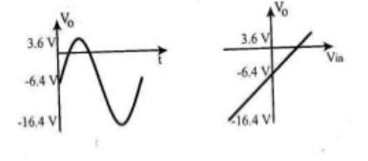
Vo = Vin-Vm+3.6

